Slide 1







The Valley: Investment Analysis
www.jamalakim.com
Follow us:

Slide 2
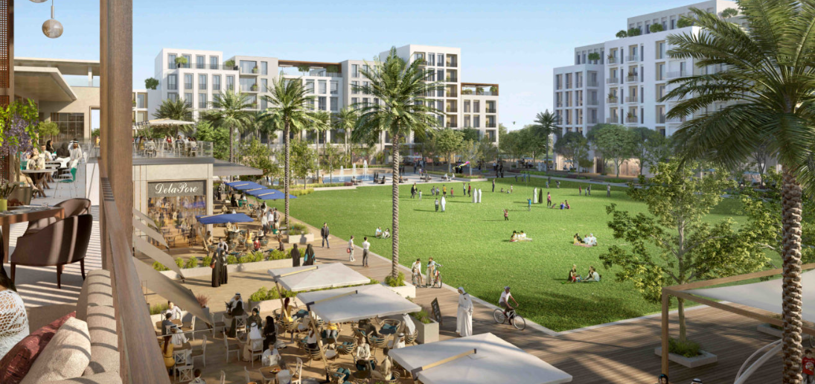







The Valley: An Overview
The Valley by Emaar is a luxurious desert oasis in the UAE that seamlessly blends modern living with traditional charm. This masterfully planned community offers pristine landscapes, premium amenities, and sophisticated residences, creating an environment where urban convenience meets natural tranquility.
Key Highlights & Statistics
47,000 sqm
3,000 sqm
32,000 sqm
Golden Beach
Pocket Park
Town Centre
25,000 sqm
61,000 sqm
83%
Sports Village
Area
Remarkable ROI
www.jamalakim.com
Notes:
Ranked among top 20 brokerages for all real estate developers

Slide 3
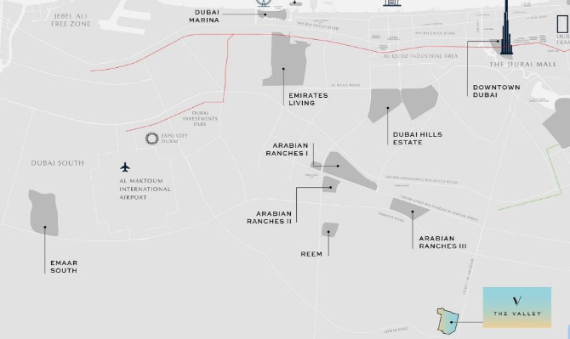






Location and Connectivity
Prime Location
The Valley Phase 2 offers a strategic location near Al Maktoum Airport, providing exceptional accessibility and investment potential. Its proximity to Dubai-Al Ain Road and anticipated airport expansion promise attractive property value growth and rental opportunities in a serene, well-positioned development.
Key Landmarks
15 Mins
15 Mins
20 Mins
Al Maktoum International Airport
Dubai Academic City
Dubai Silicon Oasis
15 Mins
15 Mins
25 Mins
Global Village
NMC Royal Hospital
Downtown Dubai
www.jamalakim.com
Notes:
Ranked among top 20 brokerages for all real estate developers

Slide 4
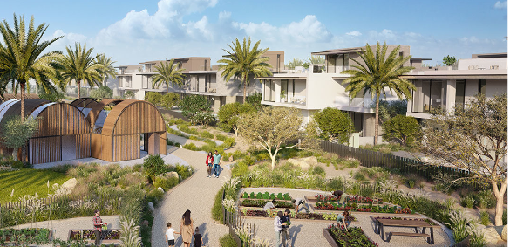
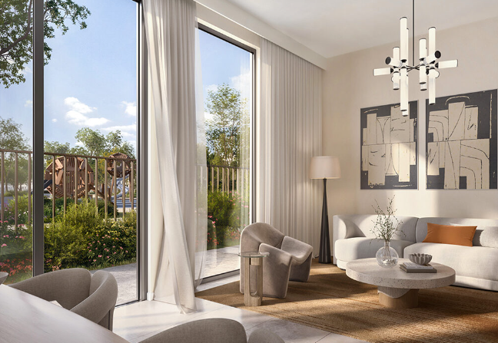
The Valley: Luxury Townhouse Collection
Discover a new standard of sophisticated living with our 3–5-bedroom configurations, tailored to meet your every need.
Exquisite Clusters
Luxurious Amenities
Choose from eight meticulously planned clusters, each offering a unique living experience:
Eden: Serene garden oasis
Nara: Zen-inspired tranquility
Talia: Mediterranean charm
Orania: Contemporary elegance
The Farm Gardens: Rural sophistication
Elora: Riverside luxury
Rivana: Urban chic
Nima: Minimalist perfection
Indulge in the epitome of comfort with premium features:
Spacious living areas for entertaining and relaxation
State-of-the-art kitchens with top-of-the-line appliances
Private terraces with panoramic views
Smart home technology for effortless living
www.jamalakim.com
Notes:
Ranked among top 20 brokerages for all real estate developers

Slide 5






The Valley: Key Amenities
Convenient Shopping
State-of-the-Art Fitness
Beach Access
On-site supermarket for hassle-free grocery shopping and daily necessities
Modern gym facilities to help residents maintain a healthy, active lifestyle
Exclusive access to pristine beaches for relaxation and water activities
Family-Friendly Spaces
Vibrant Town Centre
Education and Healthcare
Safe and fun children's play areas for young residents to enjoy
Enjoy a variety of retail outlets, dining options, and entertainment venues
Access top-quality schools and healthcare facilities within the community
www.jamalakim.com
Notes:
Ranked among top 20 brokerages for all real estate developers

Slide 6
The Valley: Price Growth and Stabilization
1
2020-2023: Price Volatility
21% jump between 2022-2023
2
2023-2026: Steady Appreciation
Growth rate stabilized around 20-22%
3
2027-2029: Acceleration
Appreciation reaching around 25% in 2027
www.jamalakim.com
Notes:
Ranked among top 20 brokerages for all real estate developers

Slide 7
The Valley: Recent Sales Transactions
Price Trend Over Time
Source: Dubai Land Department
The price data from March to October 2024 shows prices ranging from 754.88 to 1105.66 AED/Sq ft. There is moderate price volatility, with most transactions falling between 850-1050 AED/Sq ft. A notable cluster of transactions occurred on April 15, 2024.
www.jamalakim.com
Notes:
Ranked among top 20 brokerages for all real estate developers

Slide 8
The Valley: Steady Appreciation & Phased Investment
1
2024-2025: Initial Investment
AED 884,667 invested, property value at
AED 2,948,888.
ROI peaks at 34%
2
2025-2026: Accelerated Growth
Unrealized profit jumps to AED 1,373,752.
ROI peaking at 58% in 2026
3
2027: Project Completion
Unrealized profit soars to AED 2,432,712. ROI peaks at 83% in 2027
www.jamalakim.com
Notes:
Ranked among top 20 brokerages for all real estate developers

Slide 9




Who is EMAAR?
Company Background
Key Highlights
EMAAR Properties is a leading real estate developer in Dubai, United Arab Emirates. Founded in 1997, EMAAR has grown to become a global player in the real estate industry.
EMAAR has a strong track record of delivering iconic projects, including Burj Khalifa, Dubai Mall, and Dubai Opera. The company is known for its innovative designs and commitment to sustainable development.
EMAAR's Notable Projects
Burj Khalifa
Dubai Mall
Emirates Hills
Other Significant Developments
Standing tall at 828 meters, it's the tallest building in the world. Its design is a symbol of Dubai's ambition and progress.
It is one of the world's largest shopping malls, offering a diverse range of retail, entertainment, and dining options.
This prestigious residential community features luxurious villas and townhouses designed to provide a serene and exclusive lifestyle.
EMAAR has played a pivotal role in shaping Dubai's skyline. Its portfolio includes various other prominent projects, showcasing their expertise in urban development.
www.jamalakim.com
Notes:
Ranked among top 20 brokerages for all real estate developers

Slide 10




About Us
Vision
Mission
Why Us ?
Transforming desires into tangible luxury, connecting clients with aspirational properties
To give every client the clearest possible read on a Dubai property decision before they commit
●
Unparalleled expertise in Dubai's luxury market
●
Commitment to transforming luxury desires into reality
●
Focus on both lifestyle enhancement and investment potential
●
An advisory-first approach, not a sales pitch
Our Distinctive Approach
Curated Collection
Personalized Service
Investment Focus
Global Excellence
Handpicked properties meeting exacting standards.
Tailored solutions for discerning investors.
Maximizing returns in prime real estate markets.
Setting benchmarks in international luxury property standards.
www.jamalakim.com
Notes:
Ranked among top 20 brokerages for all real estate developers

Slide 11



CONTACT US
+971 58 557 0911
hello@jamalakim.com
www.jamalakim.com
Notes:
Ranked among top 20 brokerages for all real estate developers

