Slide 1







The Oasis: Investment Analysis
www.jamalakim.com
Follow us:

Slide 2
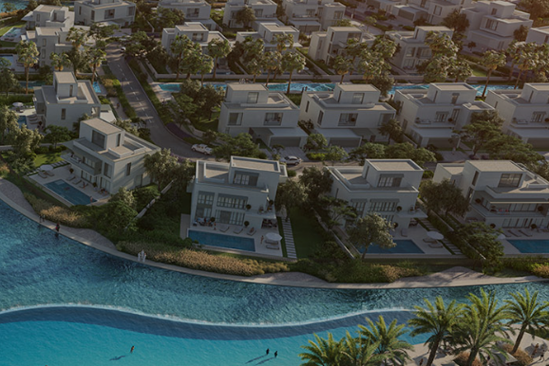







The Oasis: An Overview
Welcome to The Oasis, a visionary residential community that redefines luxury living in the heart of Dubai. This master-planned development offers a harmonious blend of sophisticated urban design and natural beauty, creating an unparalleled oasis of tranquility amidst the bustling cityscape.
Key Highlights & Statistics
100 million sq ft
+7000
40%
Total Land Area
Dedicated Green Area
Luxurious Residential Units
+20 Exclusive Facilities
75%
30%
World-Class Amenities
Remarkable Return on Investment
Reduced Energy
Consumption
www.jamalakim.com
Notes:
Ranked among top 20 brokerages for all real estate developers

Slide 3
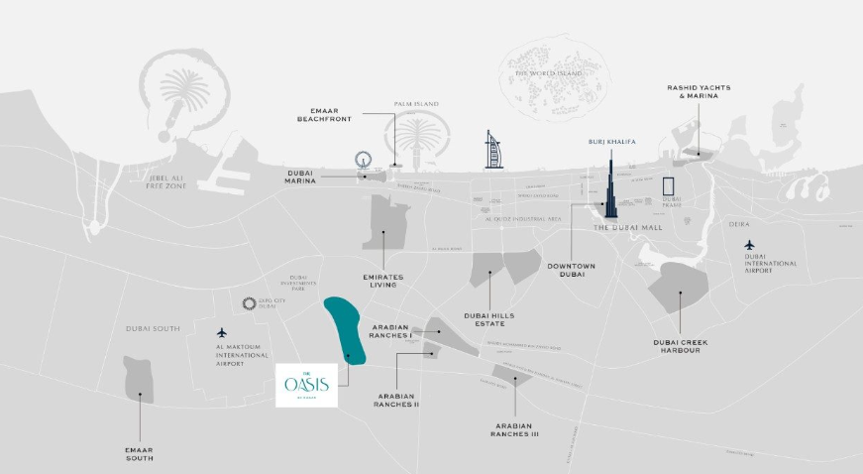







Location and Connectivity
Prime Location
The Oasis community in Dubai occupies a prime location within Dubai Silicon Oasis, a thriving tech-focused free zone. Situated in southeastern Dubai, it offers excellent connectivity via major highways while maintaining a suburban feel.
Major Highways
City Landmarks
Essential Amenities
Three major roads within 8km for seamless travel.
25-minute drive to Burj Khalifa and Dubai Mall.
Healthcare, education, and worship within 3km radius.
20-Minute Airport Access
Swift connections to Dubai International Airport.
Extensive Public Transport
RTA bus routes link to major metro stations.
Academic Hub
Proximity to Dubai Silicon Oasis University and schools.
Retail Paradise
Silicon Central Mall just 1km away.
www.jamalakim.com
Notes:
Ranked among top 20 brokerages for all real estate developers

Slide 4
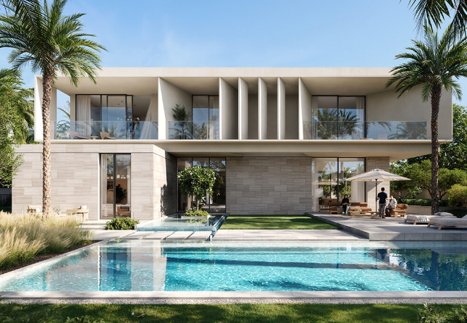
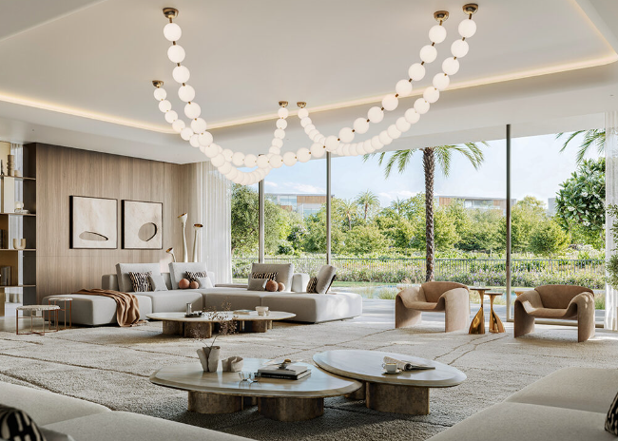
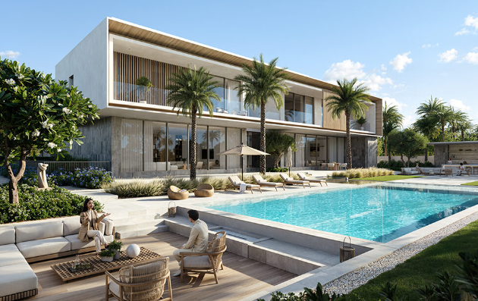
Number of Units
Total Villas & Mansions
Variety of Choices
Customization
The Oasis community comprises of about 500+ units including luxurious villas, mansions and super mansions, offering a range of sizes and layouts to suit diverse preferences.
Investors can choose from 4, 5, 6, and 7-bedroom villas, each with their own distinctive architectural features and amenities.
Buyers have the flexibility to customize their villas, allowing them to create their dream home in this exclusive community.
www.jamalakim.com
Notes:
Ranked among top 20 brokerages for all real estate developers

Slide 5
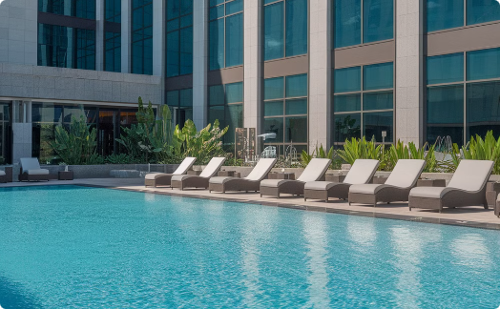
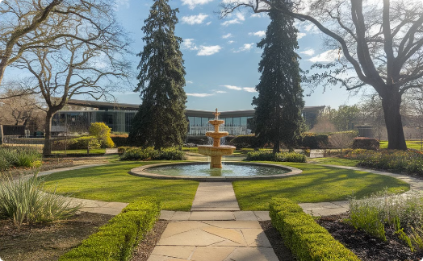
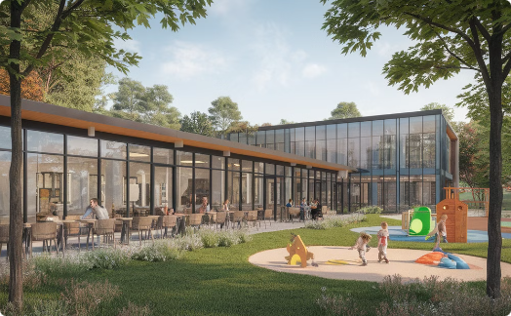
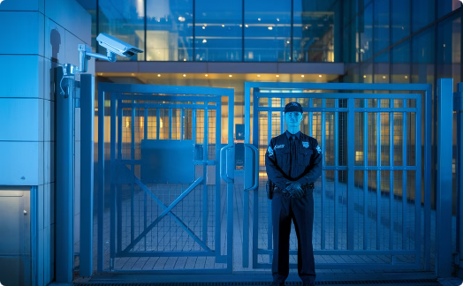
Key Amenities in The Oasis
Recreational Facilities
Landscaped Gardens
Community Facilities
24/7 Security
Residents can enjoy a range of world-class recreational amenities, such as swimming pools, fitness centers, and sports courts.
The Oasis offers beautifully landscaped gardens and green spaces, providing a serene and tranquil living environment.
The community center and other shared e facilities foster a strong sense of community and social interaction among residents.
Residents enjoy the peace of mind of a secure and gated community with round-the-clock security measures.
www.jamalakim.com
Notes:
Ranked among top 20 brokerages for all real estate developers

Slide 6
The Oasis: Rapid Growth and Stabilization
1
2020-2022: Explosive Growth
31.2% jump between 2021-2022.
2
2023-2026: Stabilization
Growth rate stabilized around 15-17%.
3
2027-2029: Acceleration
Growth accelerated again, reaching 20.4% in 2029.
www.jamalakim.com
Notes:
Ranked among top 20 brokerages for all real estate developers

Slide 7
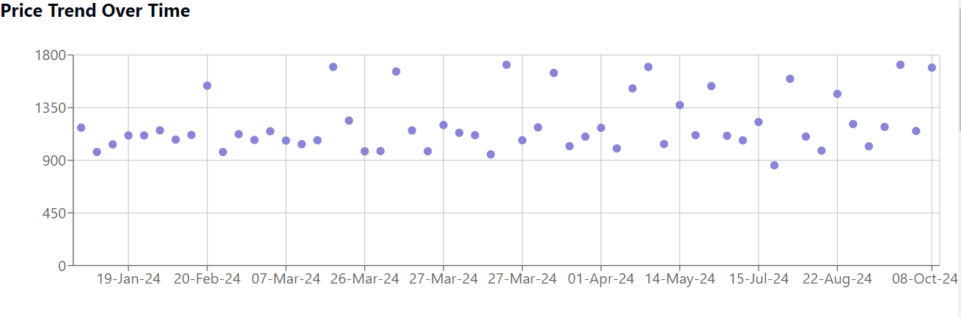
The Oasis: Recent Sales Transactions
Price Trend Over Time
Source: Dubai Land Department
The property market demonstrates significant volatility, with prices ranging from 857 to 1716 AED/sq ft. High-end transactions above 1600 AED/sq ft occur regularly, suggesting a robust luxury segment. Monthly averages fluctuate, potentially reflecting seasonal trends, with peaks in April and September. The market shows resilience, consistently rebounding from lower-priced periods.
www.jamalakim.com
Notes:
Ranked among top 20 brokerages for all real estate developers

Slide 8
The Oasis: Steady Appreciation & Phased Investment
1
2023-2025: Initial Growth
Property values rise from 1390 to
1848 AED/Sq Ft. Cumulative investment
reaches 50%. ROI peaks at 59%.
2
2026-2028: Acceleration
Appreciation rates increase yearly.
Investment plateaus at 85%.
ROI fluctuates, peaking at 84% in 2028.
3
2029: Project Completion
Property value hits 3639 AED/Sq Ft. Full investment achieved. ROI slightly dips to 75%.
www.jamalakim.com
Notes:
Ranked among top 20 brokerages for all real estate developers

Slide 9




Who is EMAAR?
Company Background
Key Highlights
EMAAR Properties is a leading real estate developer in Dubai, United Arab Emirates. Founded in 1997, EMAAR has grown to become a global player in the real estate industry.
EMAAR has a strong track record of delivering iconic projects, including Burj Khalifa, Dubai Mall, and Dubai Opera. The company is known for its innovative designs and commitment to sustainable development.
EMAAR's Notable Projects
Burj Khalifa
Dubai Mall
Emirates Hills
Other Significant Developments
Standing tall at 828 meters, it's the tallest building in the world. Its design is a symbol of Dubai's ambition and progress.
It is one of the world's largest shopping malls, offering a diverse range of retail, entertainment, and dining options.
This prestigious residential community features luxurious villas and townhouses designed to provide a serene and exclusive lifestyle.
EMAAR has played a pivotal role in shaping Dubai's skyline. Its portfolio includes various other prominent projects, showcasing their expertise in urban development.
www.jamalakim.com
Notes:
Ranked among top 20 brokerages for all real estate developers

Slide 10
Why Invest in The Oasis?
World-Class Lifestyle
Indulge in state-of-the-art fitness centers and crystal-clear pools. Stroll through meticulously manicured parks. Shop at exclusive boutiques steps from your door.
Lucrative Returns
Enjoy high rental yields and substantial capital appreciation. Benefit from Dubai's tax-free environment and investor-friendly policies. Secure freehold ownership with ease.
Potential for Value Appreciation
Rest easy with 24/7 cutting-edge security systems. Live sustainably in eco-friendly and luxurious tranquility. Trust in our developer's proven track record of excellence.
www.jamalakim.com
Notes:
Ranked among top 20 brokerages for all real estate developers

Slide 11




About Us
Vision
Mission
Why Us ?
Transforming desires into tangible luxury, connecting clients with aspirational properties
To give every client the clearest possible read on a Dubai property decision before they commit
●
Unparalleled expertise in Dubai's luxury market
●
Commitment to transforming luxury desires into reality
●
Focus on both lifestyle enhancement and investment potential
●
An advisory-first approach, not a sales pitch
Our Distinctive Approach
Curated Collection
Personalized Service
Investment Focus
Global Excellence
Handpicked properties meeting exacting standards.
Tailored solutions for discerning investors.
Maximizing returns in prime real estate markets.
Setting benchmarks in international luxury property standards.
www.jamalakim.com
Notes:
Ranked among top 20 brokerages for all real estate developers

Slide 12



CONTACT US
+971 58 557 0911
hello@jamalakim.com
www.jamalakim.com
Notes:
Ranked among top 20 brokerages for all real estate developers

