Slide 1







Expo Living: Investment Analysis
www.jamalakim.com
Follow us:

Slide 2
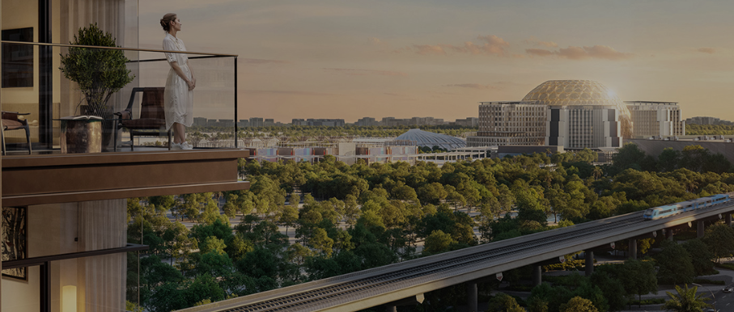





Expo Living: An Overview
Nestled in Dubai South, Expo Living offers a strategic location near Expo City and Al Maktoum Airport. This vibrant community provides easy connectivity, lush green spaces, proximity to a metro station, and the world-class Expo Mall, creating an ideal environment for modern urban living.
Key Highlights & Statistics
454,747 sqm
357,000 sqm
Total community area
Residential space
65,274 sqm
40%
Size of Dubai Expo Mall
Remarkable ROI
www.jamalakim.com
Notes:
Ranked among top 20 brokerages for all real estate developers

Slide 3
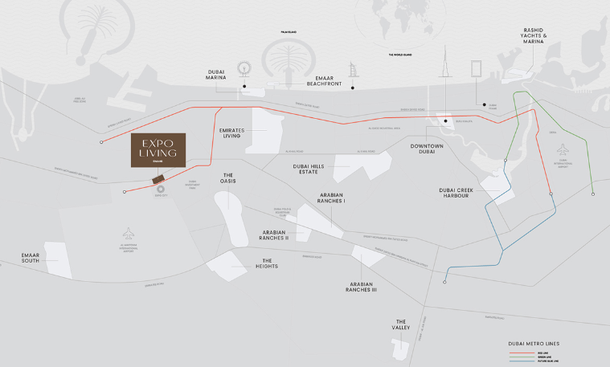





Location and Connectivity
Prime Location
Strategically positioned in Dubai South, The Expo Living community offers unparalleled proximity to Expo City, Al Maktoum International Airport, and key urban amenities. Its prime location ensures seamless connectivity, providing residents with convenient access to world-class infrastructure and dynamic metropolitan experiences.
Key Landmarks
10 Mins
15 Mins
5 Mins
Al Maktoum International Airport
Drive to Dubai Marina
Walking distance to
Expo City
3-4 Landscaped Parks
15 Mins
Withing Expo Living
Dubai Metro
www.jamalakim.com
Notes:
Ranked among top 20 brokerages for all real estate developers

Slide 4
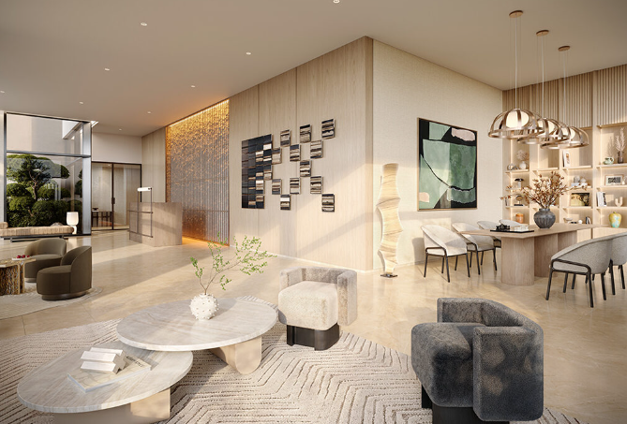
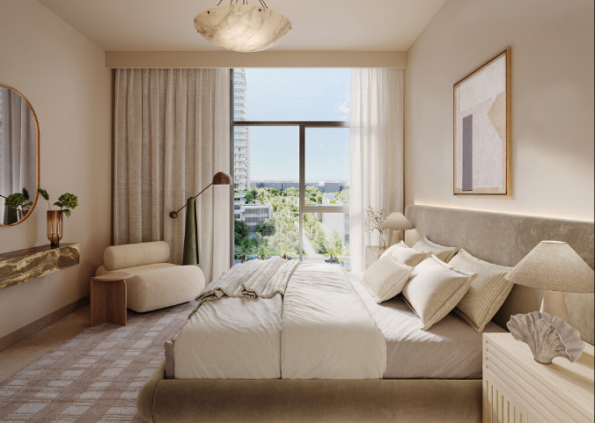
Expo Living: Tailored Spaces for Every Lifestyle
Discover the epitome of modern living in Dubai’s Expo community
1 Bedroom Apartments
2 Bedroom Apartments
Perfect for young professionals and couples, featuring spacious living areas enhanced with smart home features. Each unit offers stunning city views from private balconies, creating an ideal urban sanctuary.
Ideal for small families, these generously proportioned residences feature dual en-suite bathrooms and a gourmet kitchen. Expansive windows frame Dubai's iconic skyline, offering a perfect blend of comfort and luxury.
www.jamalakim.com
Notes:
Ranked among top 20 brokerages for all real estate developers

Slide 5






Expo Living: Key Amenities
Dual Pools
State-of-the-Art Gym
Multipurpose Sports Courts
Adult and kids' pools for year-round enjoyment
Well-equipped fitness center for all workout needs
Versatile areas for various sports and activities
Outdoor Play Areas
Social Hubs
Community Lawn
Safe, engaging spaces for children to explore and grow
BBQ spots and event rooms for memorable get-togethers
Open green space for relaxation and social gatherings
www.jamalakim.com
Notes:
Ranked among top 20 brokerages for all real estate developers

Slide 6
Expo Living: Steady Growth Rates
1
2023: Slow Start
1630 AED/Sq ft, 2.52% appreciation
2
2025: Acceleration
1750 AED/Sq ft, 6.91% appreciation
3
2028: Peak Growth
2272 AED/Sq ft, 11.30% appreciation
www.jamalakim.com
Notes:
Ranked among top 20 brokerages for all real estate developers

Slide 7
Expo Living: Steady Appreciation & Phased Investment
1
2024: Initial Investment
ROI: -9%, Appreciation: 2.52%
Cumulative Paid: 3,52,229 AED
2
2027: Positive Returns
ROI: 4%, Appreciation: 9.10%
Cumulative Paid: 8,80,574 AED
3
2028: Significant Growth
ROI: 40%, Appreciation: 11.30%.
Cumulative Paid: 17,61,147 AED
www.jamalakim.com
Notes:
Ranked among top 20 brokerages for all real estate developers

Slide 8




Who is EMAAR?
Company Background
Key Highlights
EMAAR Properties is a leading real estate developer in Dubai, United Arab Emirates. Founded in 1997, EMAAR has grown to become a global player in the real estate industry.
EMAAR has a strong track record of delivering iconic projects, including Burj Khalifa, Dubai Mall, and Dubai Opera. The company is known for its innovative designs and commitment to sustainable development.
EMAAR's Notable Projects
Burj Khalifa
Dubai Mall
Emirates Hills
Other Significant Developments
Standing tall at 828 meters, it's the tallest building in the world. Its design is a symbol of Dubai's ambition and progress.
It is one of the world's largest shopping malls, offering a diverse range of retail, entertainment, and dining options.
This prestigious residential community features luxurious villas and townhouses designed to provide a serene and exclusive lifestyle.
EMAAR has played a pivotal role in shaping Dubai's skyline. Its portfolio includes various other prominent projects, showcasing their expertise in urban development.
www.jamalakim.com
Notes:
Ranked among top 20 brokerages for all real estate developers

Slide 9




About Us
Vision
Mission
Why Us ?
Transforming desires into tangible luxury, connecting clients with aspirational properties
To give every client the clearest possible read on a Dubai property decision before they commit
●
Unparalleled expertise in Dubai's luxury market
●
Commitment to transforming luxury desires into reality
●
Focus on both lifestyle enhancement and investment potential
●
An advisory-first approach, not a sales pitch
Our Distinctive Approach
Curated Collection
Personalized Service
Investment Focus
Global Excellence
Handpicked properties meeting exacting standards.
Tailored solutions for discerning investors.
Maximizing returns in prime real estate markets.
Setting benchmarks in international luxury property standards.
www.jamalakim.com
Notes:
Ranked among top 20 brokerages for all real estate developers

Slide 10



CONTACT US
+971 58 557 0911
hello@jamalakim.com
www.jamalakim.com
Notes:
Ranked among top 20 brokerages for all real estate developers

