Slide 1







EMAAR South: Investment Analysis
www.jamalakim.com
Follow us:

Slide 2
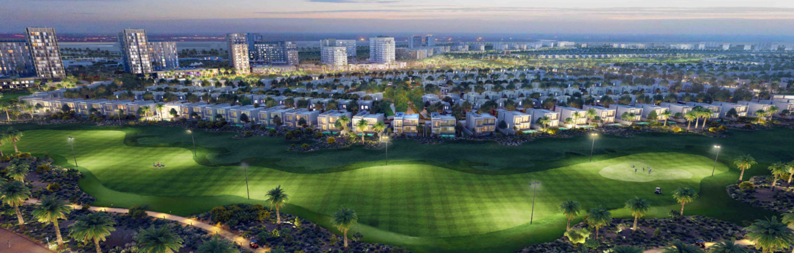





EMAAR SOUTH: An Overview
Emaar South, nestled in Dubai South near Al Maktoum International Airport, represents modern luxury living at its finest. This golf-centered community combines strategic location, state-of-the-art infrastructure, and verdant landscapes to create an unparalleled lifestyle destination of endless opportunities. Each home represents the perfect fusion of sophistication and comfort.
Key Highlights & Statistics
15,360
20+
53,000 sqm
18-Hole
Apartment Units
Nearby Parks
Retail and Dining Space
Championship Golf Course
www.jamalakim.com
Notes:
Ranked among top 20 brokerages for all real estate developers

Slide 3
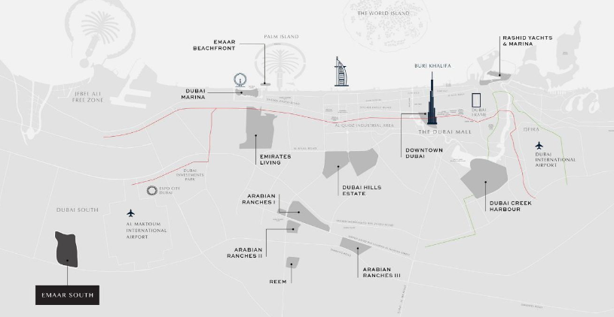



Location and Connectivity
Prime Location
Emaar South occupies a prime location in Dubai South, adjacent to Al Maktoum International Airport and the Expo 2020 site. The community enjoys seamless connectivity to major highways, including Sheikh Mohammed Bin Zayed Road and Emirates Road, enabling convenient citywide access.
Major Highway Access
Emirates Road
(E311)
Sheikh Mohammed Bin
Zayed Road (E611)
Al Qudra Road
Proximity to Key Destinations
5 Mins from
7 Mins from
20 Mins from
Al Maktoum International Airport
Expo City Dubai
Dubai Marina
www.jamalakim.com
Notes:
Ranked among top 20 brokerages for all real estate developers

Slide 4
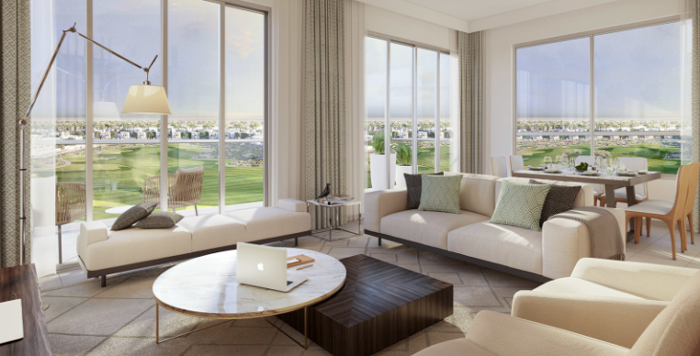
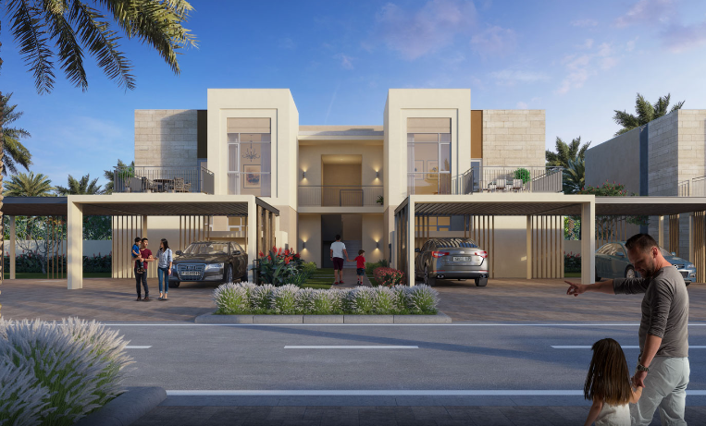
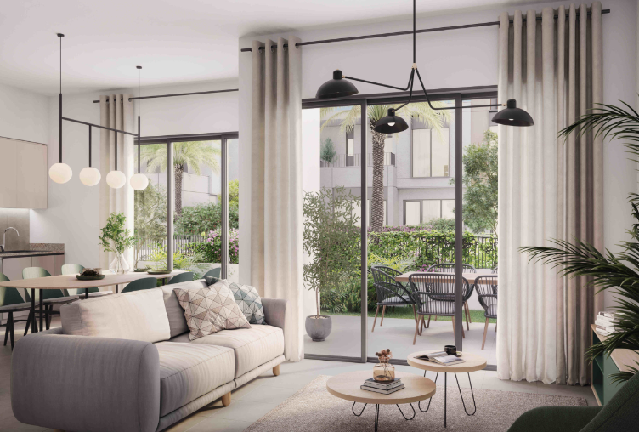
EMAAR South: Property Types
1-Bedroom Villa
2-Bedroom Villa
3 & 4-Bedroom Villas
Perfect for young professionals. Enjoy open-plan living and a private garden oasis. Smart home features elevate your daily life
Ideal for small families. Spacious living areas and a maid's room offer comfort and convenience. Double covered parking adds practicality
Ultimate luxury for growing families. Multiple balconies, study rooms, and expansive living spaces cater to your every need
www.jamalakim.com
Notes:
Ranked among top 20 brokerages for all real estate developers

Slide 5
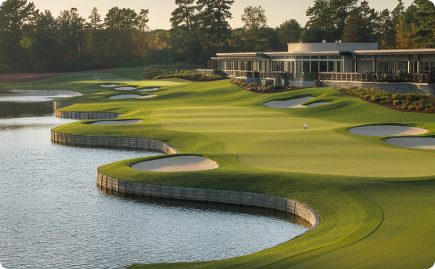
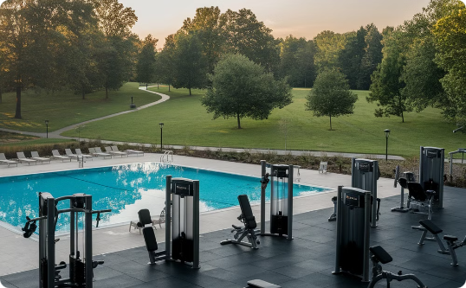
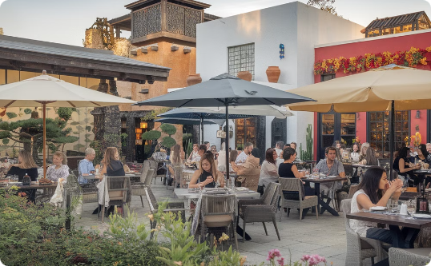
EMAAR South: Key Amenities
Championship Golf Course
Wellness and Recreation
Culinary Delights
Experience golfing excellence at the 18-hole Emaar South Golf Course. The stunning clubhouse offers premium dining and a pro shop
State-of-the-art gyms, serene swimming pools, and sports courts cater to fitness enthusiasts. Lush parks provide tranquil retreats
Indulge in diverse cuisines at upscale restaurants and cozy cafes. Savor gourmet experiences within your community
www.jamalakim.com
Notes:
Ranked among top 20 brokerages for all real estate developers

Slide 6
EMAAR South: Property Price Evolution Timeline
1
2021-2023: Steady Growth
14-39% annual appreciation. AED 570 to
810/sq ft
2
2024-2026: Accelerating Gains
42-49% annual appreciation. AED 1125 to
2316/sq ft
3
2027-2028: Explosive Surge
51% annual appreciation. AED 3451 to 5212/sq ft
www.jamalakim.com
Notes:
Ranked among top 20 brokerages for all real estate developers

Slide 7
EMAAR South: Consistent High Returns
2025
Market Entry
1
Price: 1,598 AED/sq ft
ROI: 42%
2026
Rapid Growth
2
Price: 2,316 AED/sq ft
2027
Substantial
Appreciation
ROI: 106%
3
Price: 3,451 AED/sq ft
ROI: 207%
4
2028
Peak Performance
Price: 5,212 AED/sq ft
ROI: 363%
www.jamalakim.com
Notes:
Ranked among top 20 brokerages for all real estate developers

Slide 8




Who is EMAAR?
Company Background
Key Highlights
EMAAR Properties is a leading real estate developer in Dubai, United Arab Emirates. Founded in 1997, EMAAR has grown to become a global player in the real estate industry.
EMAAR has a strong track record of delivering iconic projects, including Burj Khalifa, Dubai Mall, and Dubai Opera. The company is known for its innovative designs and commitment to sustainable development.
EMAAR's Notable Projects
Burj Khalifa
Dubai Mall
Emirates Hills
Other Significant Developments
Standing tall at 828 meters, it's the tallest building in the world. Its design is a symbol of Dubai's ambition and progress.
It is one of the world's largest shopping malls, offering a diverse range of retail, entertainment, and dining options.
This prestigious residential community features luxurious villas and townhouses designed to provide a serene and exclusive lifestyle.
EMAAR has played a pivotal role in shaping Dubai's skyline. Its portfolio includes various other prominent projects, showcasing their expertise in urban development.
www.jamalakim.com
Notes:
Ranked among top 20 brokerages for all real estate developers

Slide 9




About Us
Vision
Mission
Why Us ?
Transforming desires into tangible luxury, connecting clients with aspirational properties
To give every client the clearest possible read on a Dubai property decision before they commit
●
Unparalleled expertise in Dubai's luxury market
●
Commitment to transforming luxury desires into reality
●
Focus on both lifestyle enhancement and investment potential
●
An advisory-first approach, not a sales pitch
Our Distinctive Approach
Curated Collection
Personalized Service
Investment Focus
Global Excellence
Handpicked properties meeting exacting standards.
Tailored solutions for discerning investors.
Maximizing returns in prime real estate markets.
Setting benchmarks in international luxury property standards.
www.jamalakim.com
Notes:
Ranked among top 20 brokerages for all real estate developers

Slide 10



CONTACT US
+971 58 557 0911
hello@jamalakim.com
www.jamalakim.com
Notes:
Ranked among top 20 brokerages for all real estate developers

