Slide 1
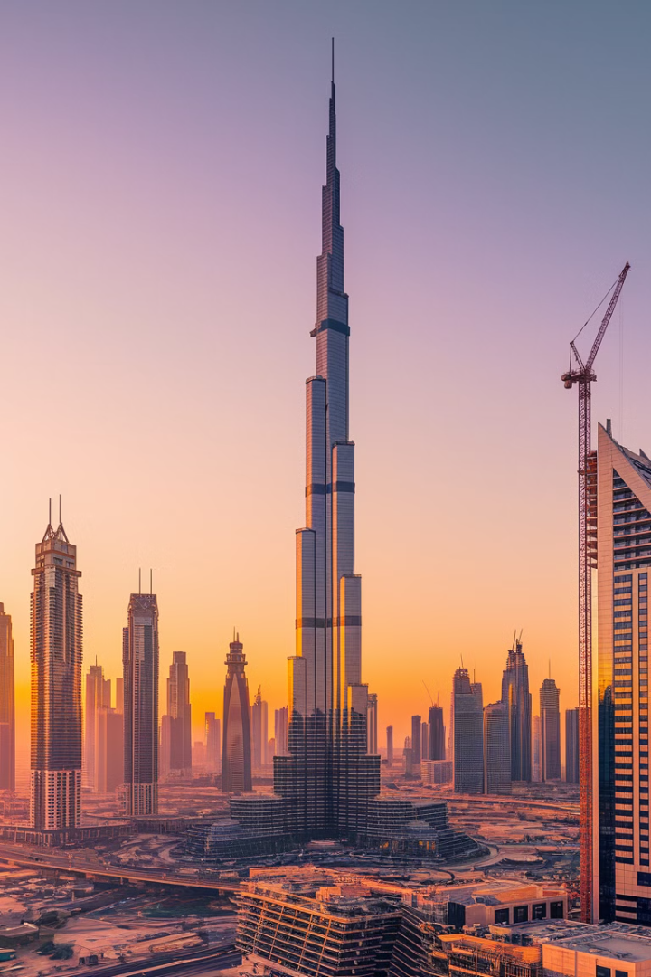

Dubai Real Estate Market Outlook 2025
Dubai's real estate market shows strong momentum in 2024. The post-pandemic recovery, government stimulus, and foreign investment have boosted sector activity. Expect organic growth through 2025 with rising property values and higher transaction volumes.

Slide 2
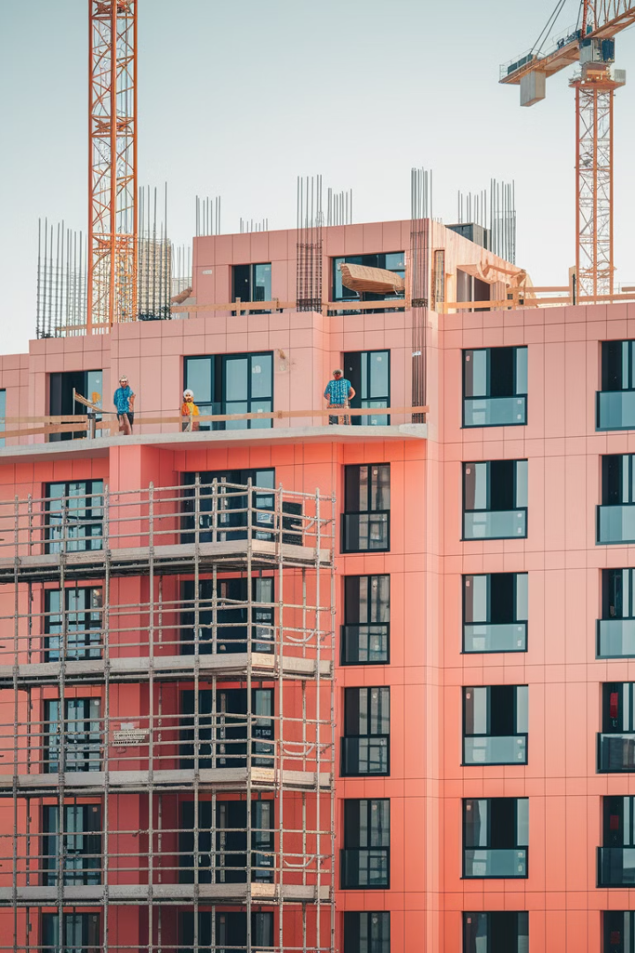
Current Market Snapshot
182K
New Units
Expected housing supply increase in 2025-2026
100K+
2025 Completions
New units finishing construction next year
43K
Transactions
Real estate deals completed in first half of 2024
41%
Price Increase
Property price growth in first half of 2024

Slide 3
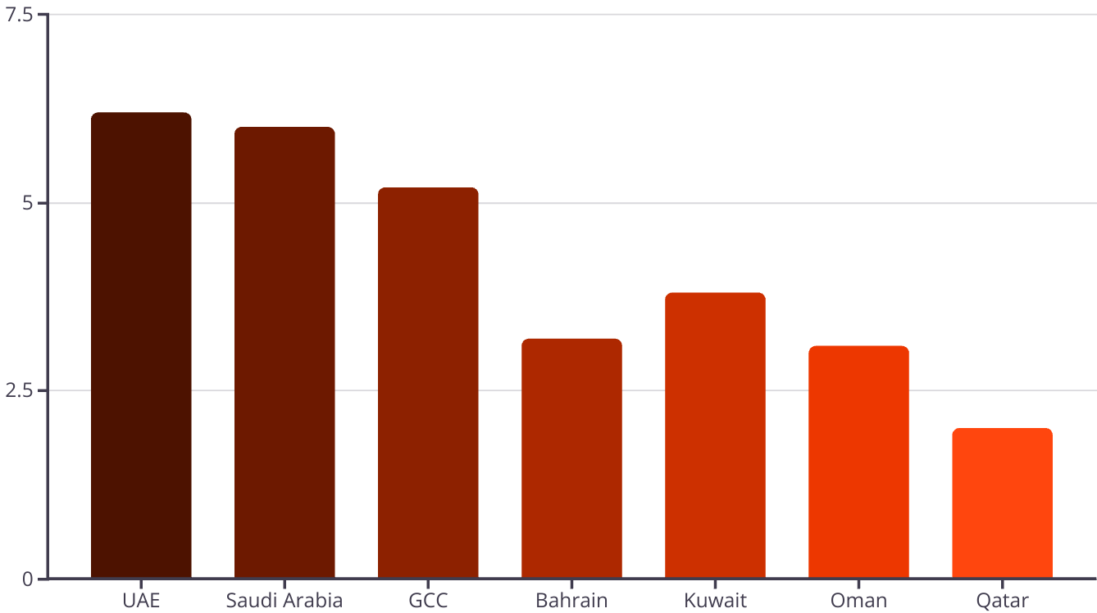
Economic Growth Forecasts
The UAE Central Bank forecasts national GDP growth of 6.2% in 2025. This growth is driven by real estate sector development. Luxury projects will decrease as developers focus on affordable and mid-range properties.

Slide 4
Supply and Demand Dynamics
Rising Supply
Strong Demand
Market Pressure
Housing supply will increase by approximately 182,000 units in 2025-2026. Over 100,000 units will complete in 2025 alone.
Investors are purchasing more expensive properties. They rent them at higher rates for passive income. Demand for rentals remains high among expats.
Increasing interest from local and international investors adds pressure on tight housing supply. This contributes to a demand-supply imbalance.

Slide 5




Foreign Investment Trends
Russian Investors
French Interest
Gulf Countries
Russian mortgage rate changes drive investors to Dubai. The 8% preferential rate ended July 2024, making domestic investment less attractive.
French investors are among top buyers of Dubai real estate. They seek opportunities for profitable investments and rental income.
Investors from neighboring Gulf nations continue to see Dubai as a prestigious and safe investment opportunity.

Slide 6
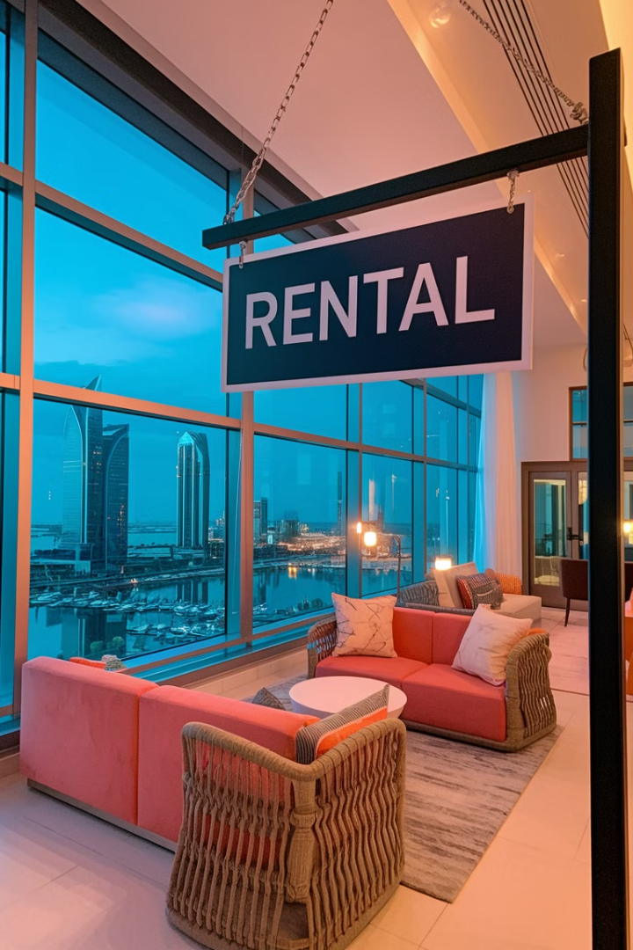
Rental Market Growth
Short-Term Rentals
Long-Term Rentals
Expected to increase by 18% in 2025 compared to 2024. These rentals last up to 6 months.
Predicted to rise by around 13% in 2025. These rentals last 6 months or more.
Price Increases
Rental prices have increased by an average of 16% since the beginning of 2024.

Slide 7
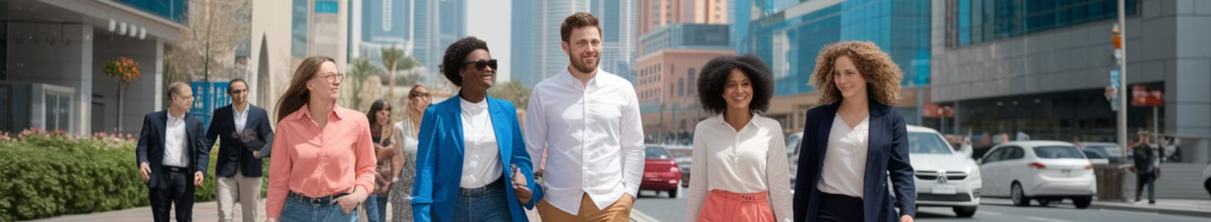
Population Growth as a Driver
Continued Trend
Rising Demand
Rising rental costs expected to persist through 2025 as population increases.
Quality of Life
Population growth drives demand for housing, pushing prices upward.
Global Professionals
Career opportunities, competitive salaries, and warm climate attract new residents.
Increasing numbers of professionals move to Dubai for work opportunities.

Slide 8





Dubai 2040 Vision
400% Increase in Beach Length
105% Increase in Green Areas
25% Increase in Health Centers
Enhancing leisure amenities and tourism attractions.
Commitment to sustainable development and quality of life.
Improving infrastructure to support growing population.
5.8 Million Population
Planned Housing Supply
Planned population increase to drive long-term demand.
Strategic development to meet future residential needs.
3
2
4
1
5

Slide 9
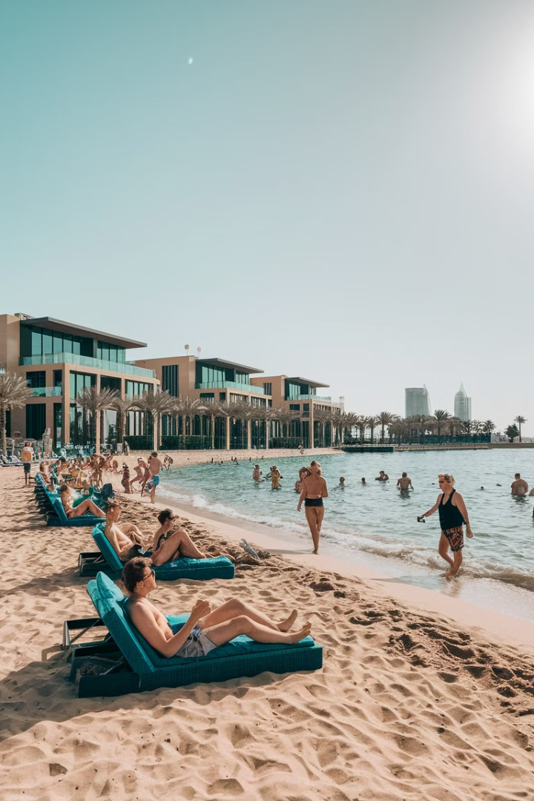



Tourism and Real Estate Connection
Tourism Growth
Record visitor numbers boost short-term rental demand and property values.
Tourism-Driven Projects
Developments cater to both tourists and residents. These create new investment opportunities.
Infrastructure Enhancement
Tourism demands drive improvements. Better facilities attract more investors and buyers.

Slide 10




Economic Diversification Benefits
Global Economic Hub
1
14th globally on Innovation Cities Index
Business-Friendly Environment
2
Zero income tax and strong capital access
Free Zones Network
3
100% foreign ownership and tax-free policies
Diversified Economy
4
Beyond oil into technology, finance, healthcare

Slide 11
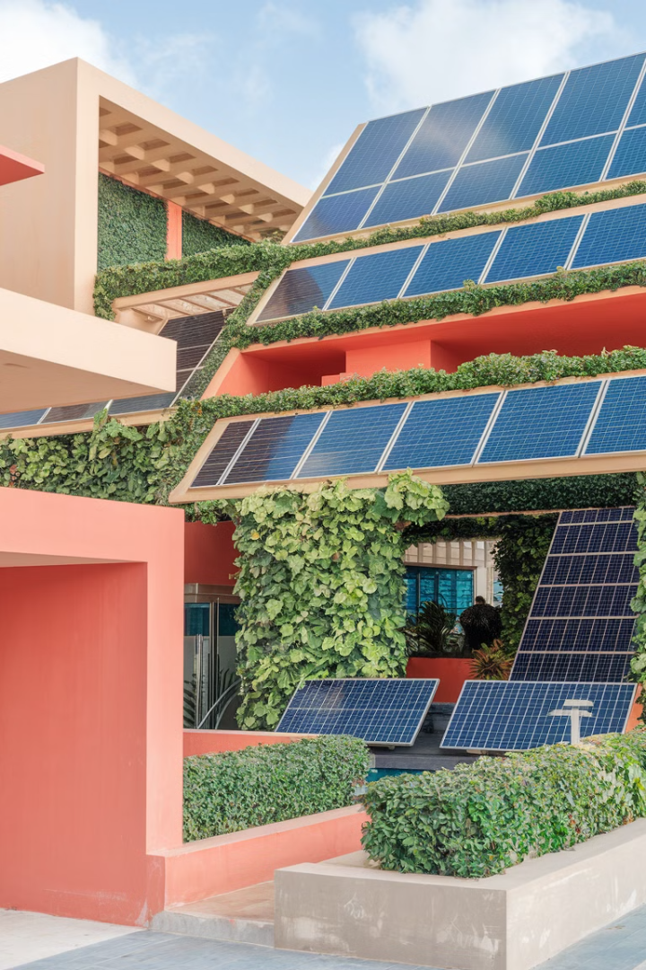
Sustainable Development Trends
1
Green Building Practices
2
Renewable Energy Integration
Commitment to sustainable development includes energy-efficient designs and green certifications.
Solar power and other renewable sources are becoming standard in new developments.
3
Eco-Friendly Communities
New developments prioritize energy efficiency, water conservation, and sustainable materials.

Slide 12




Technology and Smart City Initiatives
Blockchain for Transactions
Virtual Property Tours
1
2
Remote viewing and decision-making
Secure property deals and title deeds
4
IoT Integration
AI-Powered Solutions
3
Smart energy and maintenance systems
Advanced property management

Slide 13

Market Challenges and Considerations
1
Global Economic Conditions
Strong global economy drives up Dubai property values. Luxury segment benefits from international prosperity.
2
Rising Interest Rates
Central banks worldwide are raising rates to combat inflation. This makes borrowing more expensive.
3
Oil Price Fluctuations
As an oil-influenced region, price changes impact government spending and private wealth.
4
Transfer Fees and Taxation
4% transfer fee on property sales and new corporate tax affect investment calculations.

