Slide 1







Dubai Hills Estate: Investment Analysis
www.jamalakim.com
Follow us:

Slide 2
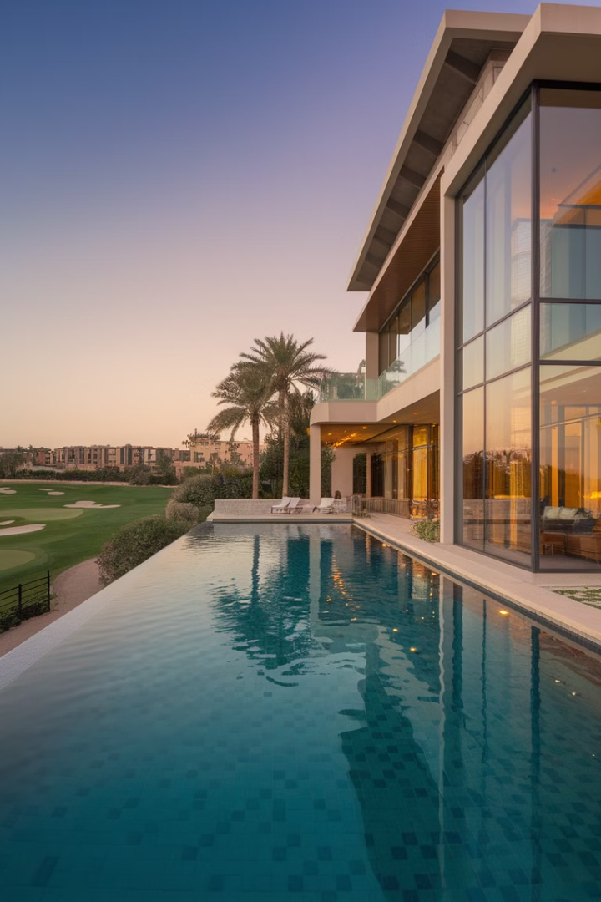





Dubai Hills Estate: An Overview
Dubai Hills Estate is a large-scale, master-planned community located in Dubai, United Arab Emirates. It is situated in the heart of the city, with easy access to major highways and the Dubai Metro.
Unparalleled Amenities and Investment Potential
World-Class Golf
Retail Paradise
18-hole championship course. Stunning views of Dubai skyline.
Dubai Hills Mall. 650+ outlets for shopping and dining.
Lush Green Spaces
Lucrative Investment
2.2 million sq. meters of parks. Serene natural oasis.
70% appreciation from 2018 to 2024. Strong market growth.
www.jamalakim.com
Notes:
Ranked among top 20 brokerages for all real estate developers

Slide 3
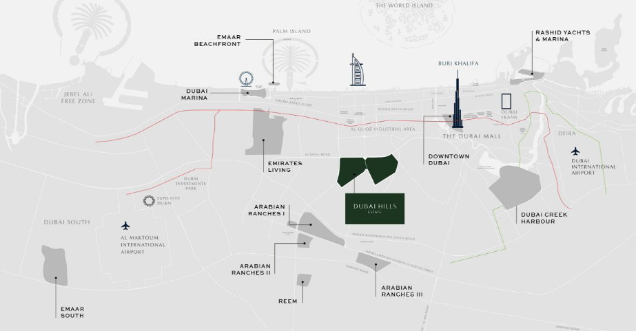







Location and Connectivity
Prime Location
Dubai Hills Estate is a sprawling development covering over 11 million square meters, located in the heart of Dubai’s new urban district, Mohammed Bin Rashid City.
Access to Major Highways
Emirates Road
Sheikh Zayed Road
Al Khail Road
E611 highway, 8 km
distant, links to outer
Dubai and beyond.
E11 highway, just 5 km
away, connects to key
business districts.
E44 route, 3 km from
estate, offers quick
acess to Dubai's heart.
Proximity to Key Landmarks
Dubai
International Airport, 22 Kms
Downtown Dubai,
15 Kms
Dubai Marina, 20 Kms
Dubai Marina, 25 Kms
www.jamalakim.com
Notes:
Ranked among top 20 brokerages for all real estate developers

Slide 4
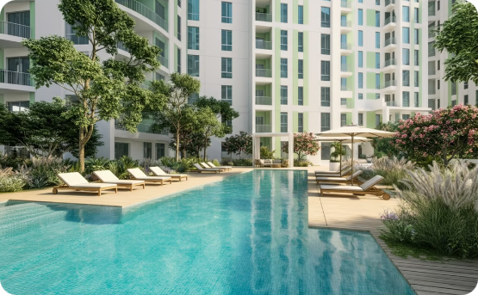
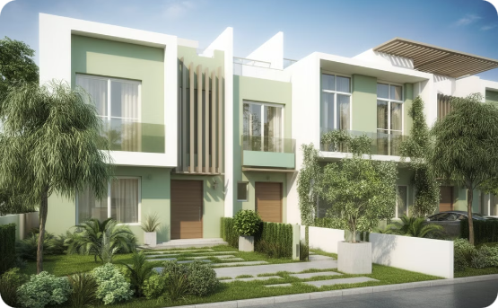
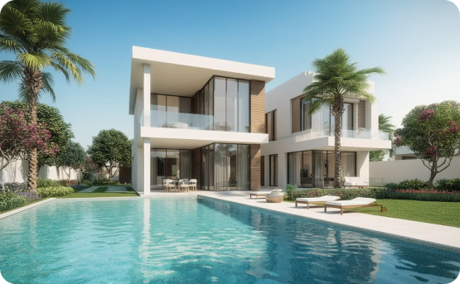
Number of Units
1000+ Apartments
100+ Townhouses
50+ Villas
Dubai Hills Estate offers a diverse range of residential options catering to various lifestyles and preferences.
Offering spacious living, townhouses provide a more private and comfortable living experience.
Luxurious and private residences, villas offer a secluded and prestigious living experience.
The development boasts a substantial number of units, ensuring ample choice for residents.
The development features over 100 townhouses, each designed for modern living.
With over 50 villas, Dubai Hills Estate provides a wide range of options for discerning homeowners.
The exact number of units varies depending on the type of apartment and the specific phase of the development.
www.jamalakim.com
Notes:
Ranked among top 20 brokerages for all real estate developers

Slide 5
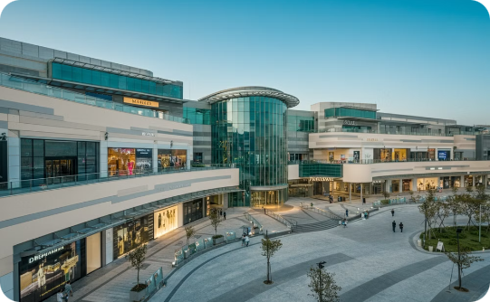

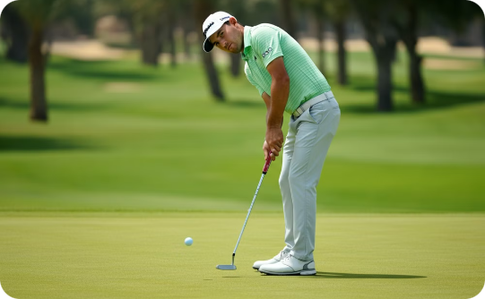

Key Amenities in Dubai Hills Estate
Dubai Hills Mall
Dubai Hills Park
Dubai Hills Golf Club
Schools, Healthcare, and Other Facilities
The Dubai Hills Mall offers a wide selection of stores, restaurants, and entertainment options. It includes a variety of luxury brands and international retailers, making it a shopper's paradise.
Dubai Hills Park provides a tranquil escape for residents and visitors alike. It features lush green spaces, walking trails, and play areas, perfect for family gatherings and leisurely strolls.
The Dubai Hills Golf Club is a championship-level course that offers a challenging yet enjoyable experience for golfers of all levels. It features 18 holes designed by renowned architect Ernie Els.
Dubai Hills Estate boasts a wide range of educational institutions, from pre-schools to international schools, ensuring quality education for residents.
www.jamalakim.com
Notes:
Ranked among top 20 brokerages for all real estate developers

Slide 6
Dubai Hills Estate: Market Resilience and Growth
1
2018-2019: Steady Foundation
Consistent appreciation, establishing market
stability.
2
2020: Brief Adjustment
Slight decline, showcasing market's adaptability.
3
2021-2024: Accelerated Growth
Impressive recovery, peaking at 14% appreciation
in 2024.
www.jamalakim.com
Notes:
Ranked among top 20 brokerages for all real estate developers

Slide 7
Dubai Hills Estate: Remarkable ROI Growth
1
Initial Investment (2018)
Property value starts at 1.5M AED. The foundation for future growth is laid.
2
Market Resilience (2020-2021)
Despite a slight dip, the market quickly recovers. ROI jumps to 38%.
3
Accelerated Growth (2022-2024)
ROI skyrockets to 325%. Property value reaches 2.48M AED, surpassing initial investment.
www.jamalakim.com
Notes:
Ranked among top 20 brokerages for all real estate developers

Slide 8
Why Invest in Dubai Hills Estate?
Strategic Location
Quality of Construction and Amenities
Dubai Hills Estate benefits from a prime location within Dubai. It offers easy access to major highways, public transport, and key attractions.
EMAAR, the developer, is known for its high-quality construction and luxurious amenities, ensuring a comfortable and enjoyable living experience.
EMAAR's Track Record
Potential for Value Appreciation
EMAAR has a proven track record of delivering successful and innovative projects, instilling confidence in investors.
Dubai Hills Estate is expected to see strong capital appreciation over time due to its desirability and strong demand.
www.jamalakim.com
Notes:
Ranked among top 20 brokerages for all real estate developers

Slide 9




Who is EMAAR?
Company Background
Key Highlights
EMAAR Properties is a leading real estate developer in Dubai, United Arab Emirates. Founded in 1997, EMAAR has grown to become a global player in the real estate industry.
EMAAR has a strong track record of delivering iconic projects, including Burj Khalifa, Dubai Mall, and Dubai Opera. The company is known for its innovative designs and commitment to sustainable development.
EMAAR's Notable Projects
Burj Khalifa
Dubai Mall
Emirates Hills
Other Significant Developments
Standing tall at 828 meters, it's the tallest building in the world. Its design is a symbol of Dubai's ambition and progress.
It is one of the world's largest shopping malls, offering a diverse range of retail, entertainment, and dining options.
This prestigious residential community features luxurious villas and townhouses designed to provide a serene and exclusive lifestyle.
EMAAR has played a pivotal role in shaping Dubai's skyline. Its portfolio includes various other prominent projects, showcasing their expertise in urban development.
www.jamalakim.com
Notes:
Ranked among top 20 brokerages for all real estate developers

Slide 10




About Us
Vision
Mission
Why Us ?
Transforming desires into tangible luxury, connecting clients with aspirational properties
To give every client the clearest possible read on a Dubai property decision before they commit
●
Unparalleled expertise in Dubai's luxury market
●
Commitment to transforming luxury desires into reality
●
Focus on both lifestyle enhancement and investment potential
●
An advisory-first approach, not a sales pitch
Our Distinctive Approach
Curated Collection
Personalized Service
Investment Focus
Global Excellence
Handpicked properties meeting exacting standards.
Tailored solutions for discerning investors.
Maximizing returns in prime real estate markets.
Setting benchmarks in international luxury property standards.
www.jamalakim.com
Notes:
Ranked among top 20 brokerages for all real estate developers

Slide 11



CONTACT US
+971 58 557 0911
hello@jamalakim.com
www.jamalakim.com
Notes:
Ranked among top 20 brokerages for all real estate developers

