Slide 1







Dubai Creek Harbour: Investment Analysis
www.jamalakim.com
Follow us:

Slide 2
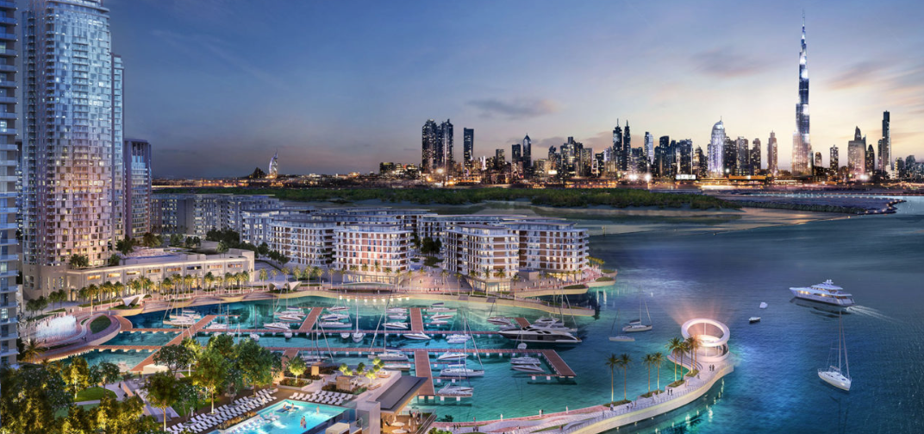





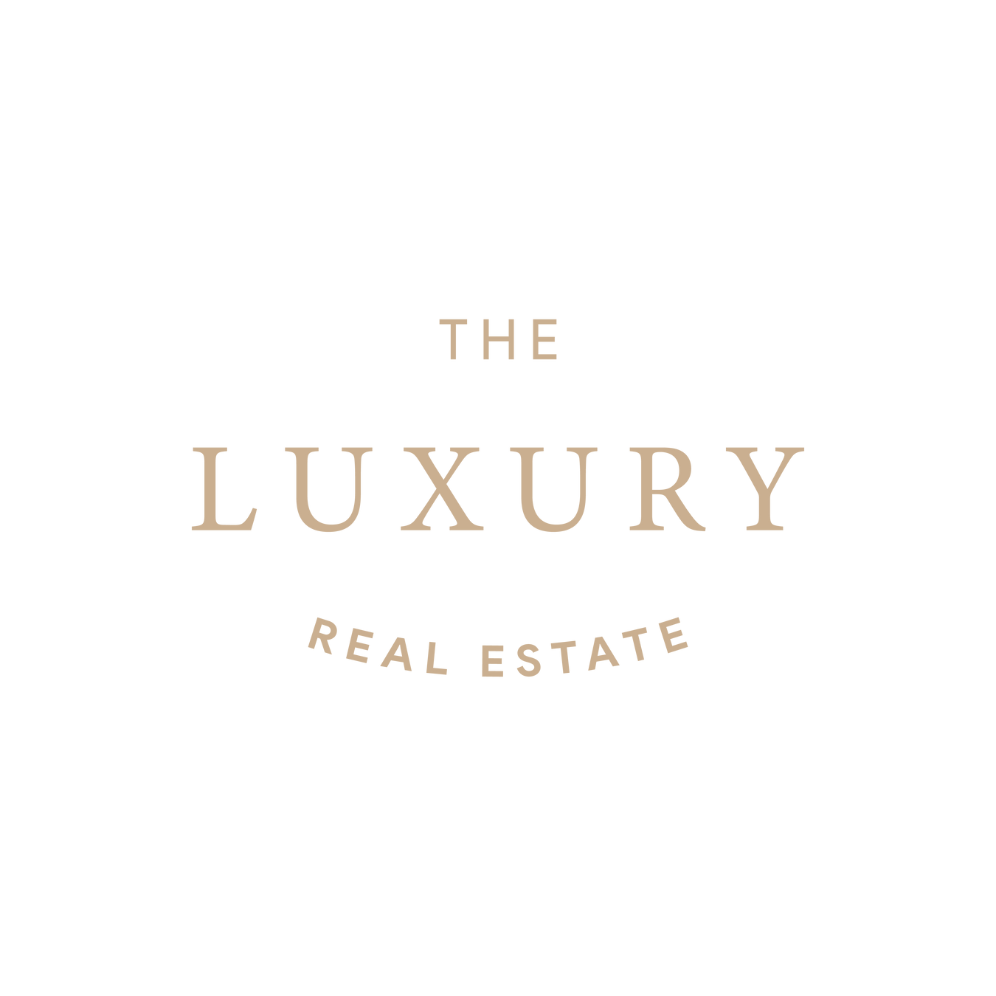
Dubai Creek Harbour: An Overview
Dubai Creek Harbour is a prestigious waterfront development in Dubai spanning 6 square kilometers. This master-planned community features luxury residences, Dubai Creek Tower, retail districts, and marina facilities, offering stunning views of the creek and Dubai's skyline while emphasizing sustainable living.
Key Highlights & Statistics
Around 711,399 sq m
Around 500,000 sq m
Around 7,400,000 sq m
Around 851,000 sq m
Around 769,000 sq m
Serviced Apartment
Parks and Open Space
Residential Space
Commercial Space
Retail Space
www.jamalakim.com
Notes:
Ranked among top 20 brokerages for all real estate developers

Slide 3
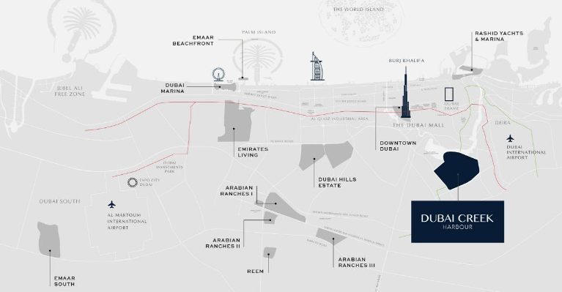



Location and Connectivity
Prime Location
Dubai Creek Harbour enjoys a prime location on the historic Dubai Creek, just 10 minutes from Downtown Dubai. This waterfront development sits opposite the Ras Al Khor Wildlife Sanctuary, offering stunning views of both Dubai's skyline and natural wetlands while providing excellent connectivity to major highways.
Major Highway Access
Direct access to
Ras Al Khor Road
Easy connection to
Al Khail Road
Quick access to
Business Bay Crossing
Proximity to Key Destinations
10 Mins to
15 Mins to
25 Mins to
Dubai International Airport
Downtown Dubai
Dubai Marina
www.jamalakim.com
Notes:
Ranked among top 20 brokerages for all real estate developers

Slide 4
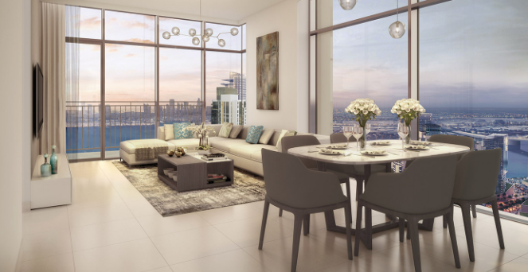
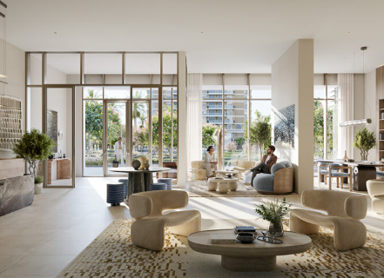
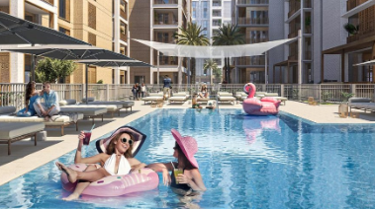
Dubai Creek Harbour: Luxury Living Redefined
Apartments & Penthouses
Luxurious Villas
World-Class Amenities
Discover sleek 1-4 bedroom apartments and penthouses. High-end finishes and breathtaking views come standard. Smart home technology enhances your living experience
Indulge in spacious villas with private pools and gardens. Cutting-edge amenities cater to discerning tastes. Bespoke interiors reflect Dubai's cosmopolitan lifestyle
Indulge in infinity pools, state-of-the-art fitness centers, and exclusive residents' lounges. Concierge services cater to your every need.
www.jamalakim.com
Notes:
Ranked among top 20 brokerages for all real estate developers

Slide 5
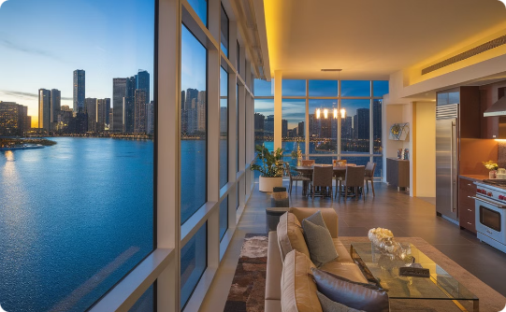
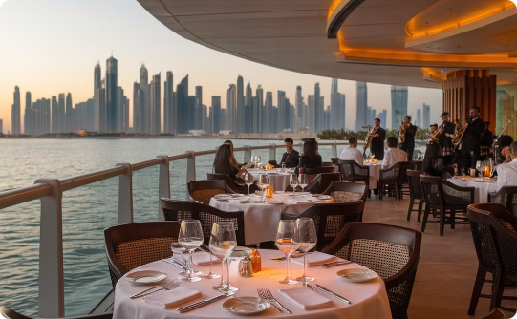
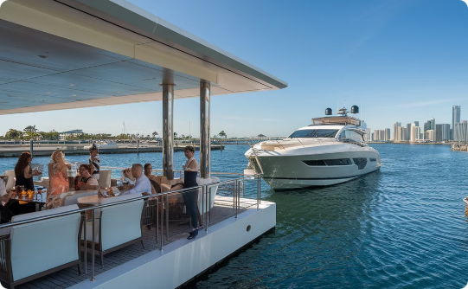
Dubai Creek Harbour: Key Amenities
Serene Waterfront Residences
World-Class Culinary Experiences
Exclusive Yacht Club
Wake up to panoramic water views in your luxurious apartment. Floor-to-ceiling windows frame the sparkling creek and Dubai skyline.
Savor exquisite cuisine at Michelin-starred restaurants. Indulge in molecular gastronomy or authentic local flavors with waterfront vistas.
Access the prestigious Creek Marina Yacht Club. Enjoy private lounges, concierge services, and world-class sailing facilities.
www.jamalakim.com
Notes:
Ranked among top 20 brokerages for all real estate developers

Slide 6
Dubai Creek Harbour: Property Price Evolution Timeline
1
2019-2022: Steady Growth
Moderate increases, 1-15% annual growth,
1491 to 1755 AED/sq ft
2
2023-2025: Accelerated Appreciation
18-19% growth, prices more than double,
2012 to 5168 AED/sq ft
3
2026-2028: Explosive Surge
19.7-20.4% growth, prices increase tenfold, 11317 to 54798 AED/sq ft
www.jamalakim.com
Notes:
Ranked among top 20 brokerages for all real estate developers

Slide 7
Dubai Creek Harbour: Exponential Returns
2025
Initial Growth
1
Profit: 1,954,263 AED
ROI: 119%
2026
Rapid Expansion
2
Profit: 6,241,372 AED
2027
Exponential
Surge
ROI: 379%
3
Profit: 15,685,701 AED
ROI: 951%
4
2028
Peak Performance
Price: 36,556,509 AED
Note – Considering the starting price of the property of AED 1,648,888 in 2024.
ROI: 2217%
www.jamalakim.com
Notes:
Ranked among top 20 brokerages for all real estate developers

Slide 8




Who is EMAAR?
Company Background
Key Highlights
EMAAR Properties is a leading real estate developer in Dubai, United Arab Emirates. Founded in 1997, EMAAR has grown to become a global player in the real estate industry.
EMAAR has a strong track record of delivering iconic projects, including Burj Khalifa, Dubai Mall, and Dubai Opera. The company is known for its innovative designs and commitment to sustainable development.
EMAAR's Notable Projects
Burj Khalifa
Dubai Mall
Emirates Hills
Other Significant Developments
Standing tall at 828 meters, it's the tallest building in the world. Its design is a symbol of Dubai's ambition and progress.
It is one of the world's largest shopping malls, offering a diverse range of retail, entertainment, and dining options.
This prestigious residential community features luxurious villas and townhouses designed to provide a serene and exclusive lifestyle.
EMAAR has played a pivotal role in shaping Dubai's skyline. Its portfolio includes various other prominent projects, showcasing their expertise in urban development.
www.jamalakim.com
Notes:
Ranked among top 20 brokerages for all real estate developers

Slide 9




About Us
Vision
Mission
Why Us ?
Transforming desires into tangible luxury, connecting clients with aspirational properties
To give every client the clearest possible read on a Dubai property decision before they commit
●
Unparalleled expertise in Dubai's luxury market
●
Commitment to transforming luxury desires into reality
●
Focus on both lifestyle enhancement and investment potential
●
An advisory-first approach, not a sales pitch
Our Distinctive Approach
Curated Collection
Personalized Service
Investment Focus
Global Excellence
Handpicked properties meeting exacting standards.
Tailored solutions for discerning investors.
Maximizing returns in prime real estate markets.
Setting benchmarks in international luxury property standards.
www.jamalakim.com
Notes:
Ranked among top 20 brokerages for all real estate developers

Slide 10



CONTACT US
+971 58 557 0911
hello@jamalakim.com
www.jamalakim.com
Notes:
Ranked among top 20 brokerages for all real estate developers

